Slide 1
MATPLOTLIB PYTHON IMAGE MANIPULATION
Dissecting Matplotlib Image Data (Andrew Garcia, 2016)

Slide 2
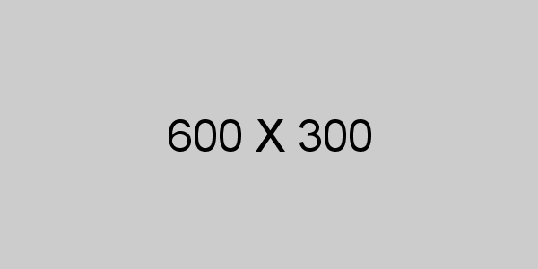
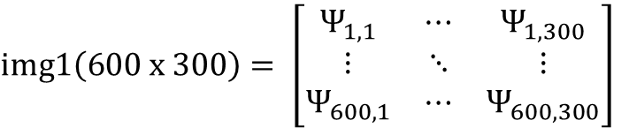
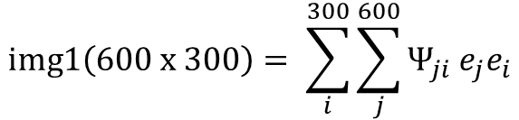

To recapitulate, the image was transformed to a code that captured the color of the 600 x 300 pixels with by assigning a set of numbers to each pixel.
However, during such transformation, the array has elucidated dimensions of 300 x 600 (thus shifted from the actual image by 90 degrees)
For a 1-element pixel representation: The relative shading (grayscale) of the pixel is represented with a number between 0 and 1
$$img1\left(600 x 300\right)= \sum_{i}^{300}{\sum_{j}^{600}{Ψ_{ji} e_{j}e_{i}}}$$
$img1\left(600 x 300\right)= \left[\begin{matrix}Ψ_{1,1} & ⋯ & Ψ_{1,300} \\ ⋮ & ⋱ & ⋮ \\ Ψ_{600,1} & ⋯ & Ψ_{600,300}\end{matrix}\right]$
$${0<Ψ}_{ji}<1$$

Slide 3







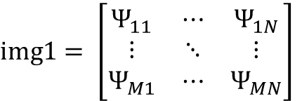
Algorithm FOR SELECTIVE COLORING / DEPTH
We can define a series of points with a pixel value lower than a specific number (i.e. a constraint) in an x-and y array, making the z dimension a series of different constraints.
(Remember to shift from array to image, shift from y –x pixels to x - y values)
ALGORITHM:
For i = 1 to M:
For j = 1 to N:
If pixel value from location “i,j” (Ψ[i,j]) < [certain value of Ψ (i.e. any number between 0 and 1)]:
x-vector[]= j
y-vector[]= i
REPEAT for different “If Ψ < z” constraints.
$img1= \left[\begin{matrix}Ψ_{11} & ⋯ & Ψ_{1N} \\ ⋮ & ⋱ & ⋮ \\ Ψ_{M1} & ⋯ & Ψ_{MN}\end{matrix}\right]$
$Ψ_{11}=0.08(<0.10$)
$Ψ_{21}=0.12(>0.10$)
$Ψ_{12}=0.09 (>0.10$)
$Ψ_{22}=0.06 (<0.10$)
$$⋮$$
$$x= \left[1 2 2 ⋯\right]$$
$$y= \left[1 1 2 ⋯\right]$$

Slide 4
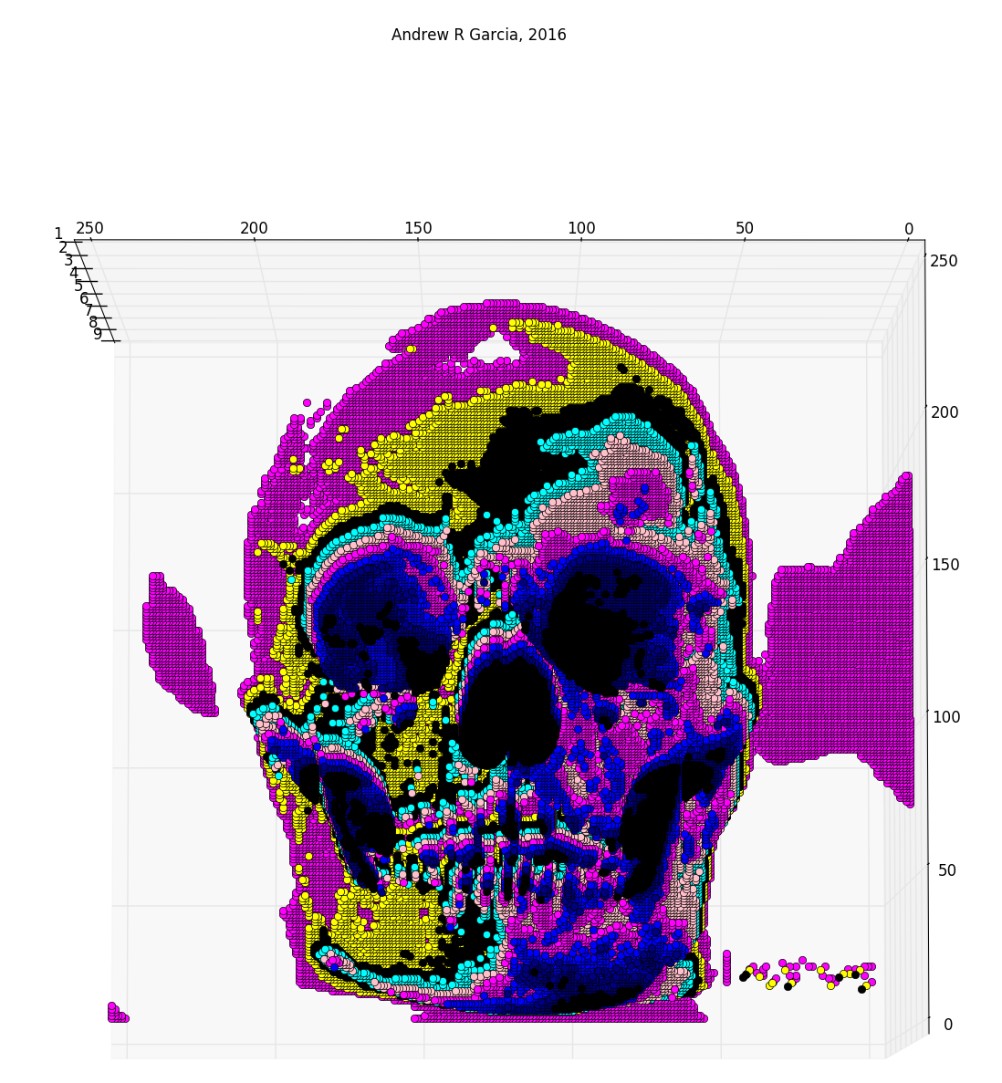
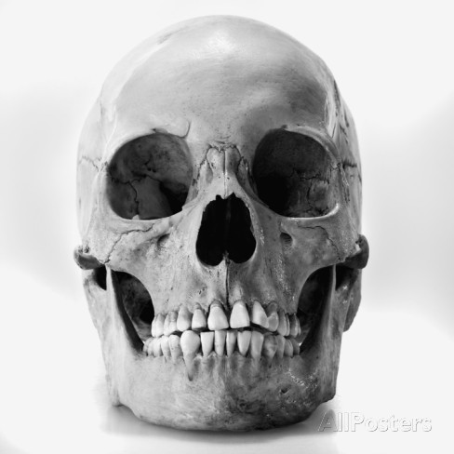
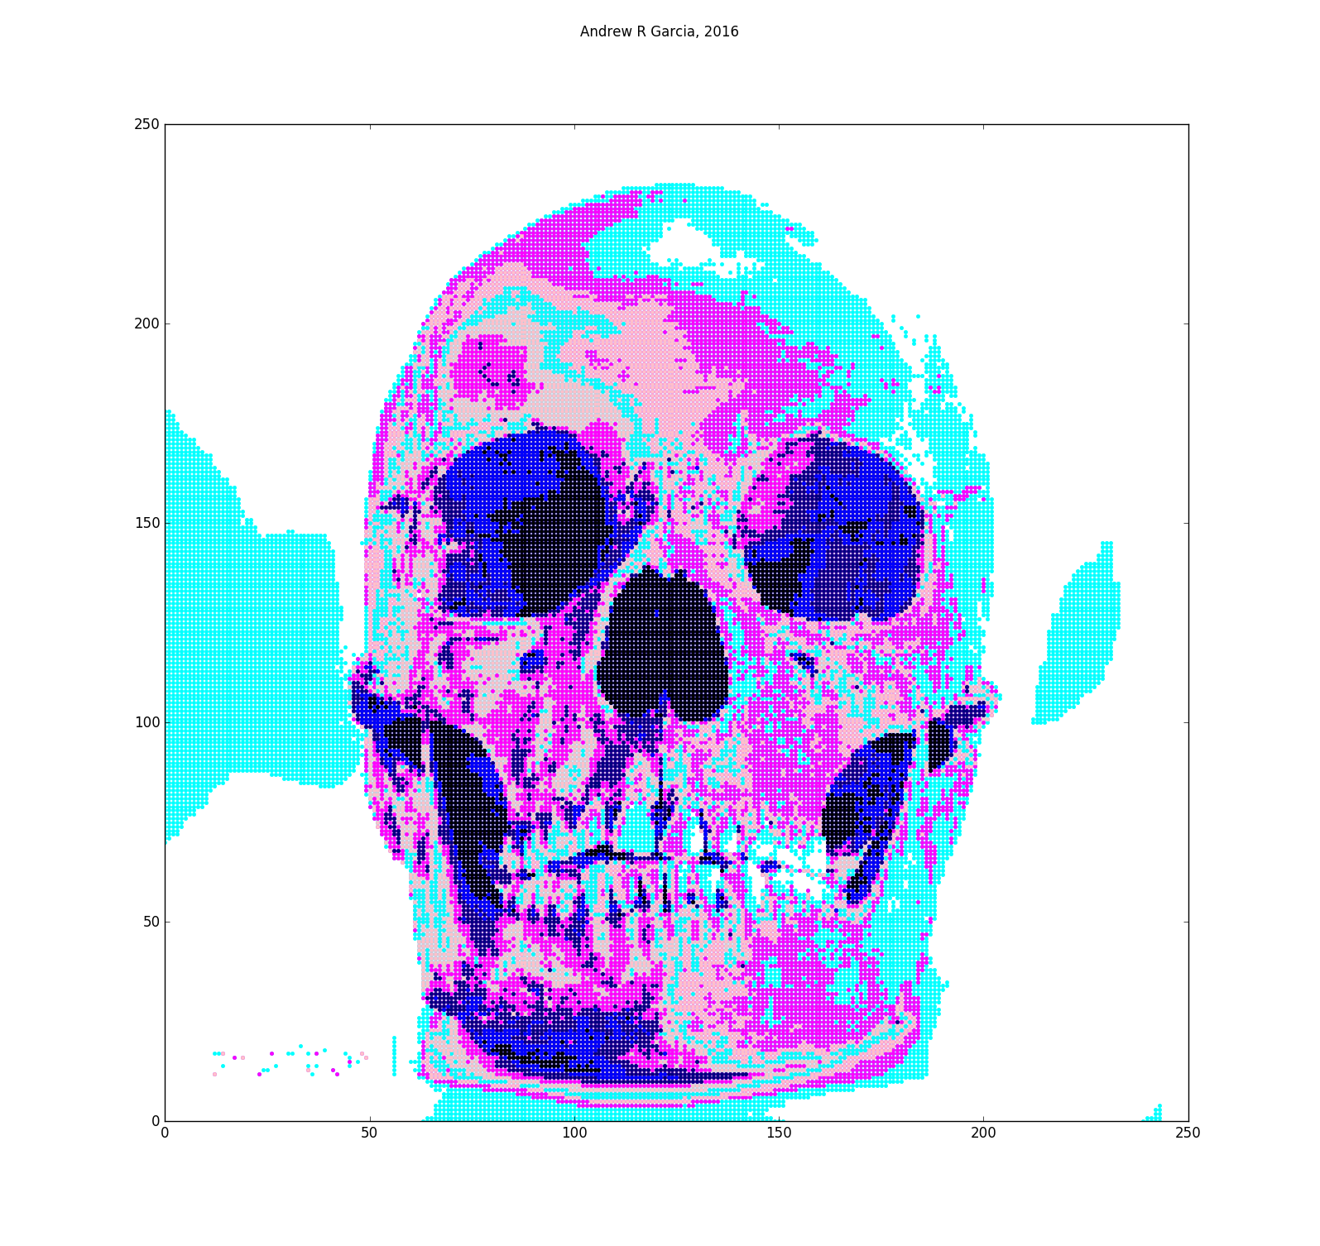
Using what was explained in the video and the previously mentioned algorithm you can make a program to turn images to:
Transform an image to a code that represents the relative color of all of its pixels.
Re-color / add depth to the image.

